Slide 1
Unmasking Latinx Ministry
Latinx Ministry: A Program of the Church

Slide 2
Goals of this presentation
Brief history of the institutionalization of Latinx Ministries as a program. (1967-present)
(Re)focus TEC toward and remind about the basic understanding of Ministry and therefore the Mission of the Church.
Unmask the challenges of having ministry to, with, and among Latinx persons and communities be a hyphenated-ministry.
Power, Resources, and Epistemologies: A Decolonial Approach

Slide 3
Chronological Highlights
1967 – Presiding Bishop Hines and the General Convention Special Program
1971 – First Latinx Officer (Rivera)
1973 – Second Latinx Officer (Cueto); Creation of “Ethnic Ministries”
1974 – Presiding Bishop Allin
1977 – Third Latinx Officer (Arrunátegui)
1980 – Report on the mandated GC Latinx Ministry survey
1980/82 – Provisional Hymnal and Libro de Oración Común
1980s – Flourish of Latinx Theological Work
1985 – Presiding Bishop Browning

Slide 4
Chronological Highlights, cont…
1999 – Fourth Latinx Officer (Caballero)
2000 – Inception of Nuevo Amanecer (then 2008)
2001 – Atlanta Manifesto
2005 – Fifth Latinx Officer (Guillén)
2009 – Ripe Fields (Oliver)
2009 – Strategic Vision Document
2013 – Nuevos Horizontes (A. Rodríguez)
2014 – New Camino
2015 - History of Hispanic Ministries (I. Rodríguez)
2017 – First ELMC Course
2018-2019 – Theologizing Latinamente Conference and ATR issue

Slide 5
#BCP855: Ministry and the Mission of the Church
What is ministry?
Actions of ministry
What it is not…
Who are the ministers?
What is the aim?
The Mission of the Church (#BCP855)

Slide 6
Unmasking Latinx Ministry: A Program of the Church
Latinx Ministry is co-terminus with Ministry
Otherwise it is…
Hyphenated-Ministry
A commodification of a particular group
Solely looks at Latinx persons and communities as “deficient”

Slide 8
A Demographic Panic
Latinx persons and communities will not save the Episcopal Church from itself.
Recovering and Renewing the Tradition
Dismantling the institution

Slide 9
If not the Mission of the Church, then…
The challenge of evangelization
The inability of a racist and misogynist Church to share power and resources
Theological Education
House of Bishops
The epistemological challenge

Slide 10
Power and Resources
Budgets say a lot about institutions.
Programs
Follow the money
Where does power reside in TEC?
Who holds power?
Where are the resources?
Who has the resources?

Slide 11
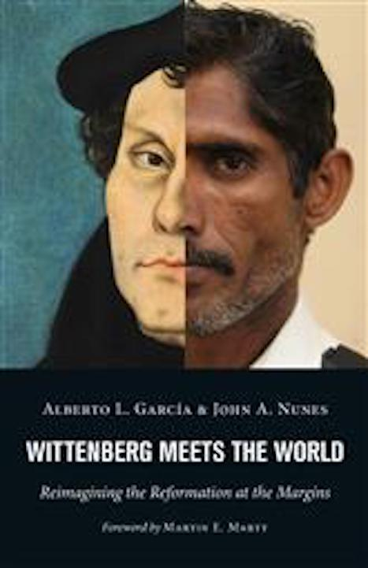
The Selling of Indulgences
Latinx persons and communities will not fund the crusades nor the building of St. Peter’s.
From commodification to a willingness to be evangelized by the poor among us.

Slide 12
Undoing Coloniality: The Role of Seminary Education
What is Coloniality? The “other side” of modernity
The classification of peoples since the 15th century by race
The building up of capital by some by exploiting the other.
A local epistemology being made universal at the expense of other epistemologies.

Slide 13
Questions and Discussion

Slide 14
Unmasking Latinx Ministry for Episcopalians: An Anglican Approach
Thank you!
Available today from the Church Publishing Booth and on pre-order at Amazon.com
Shop through smile.amazon.com and choose “ Church of St. Matthew and St. Timothy” as your charity.

