Slide 1
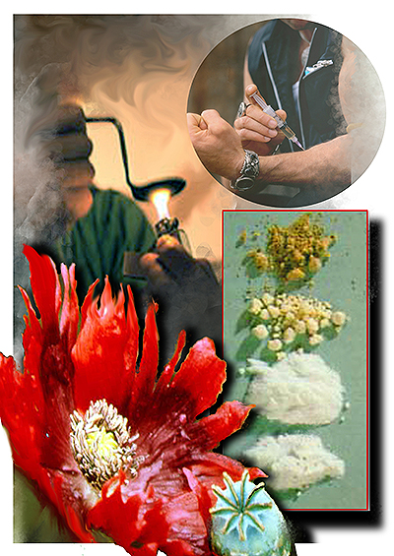
Mid-Atlantic OCDETF Presents Trojan Horse…
Heroin: A Year Later

Slide 2
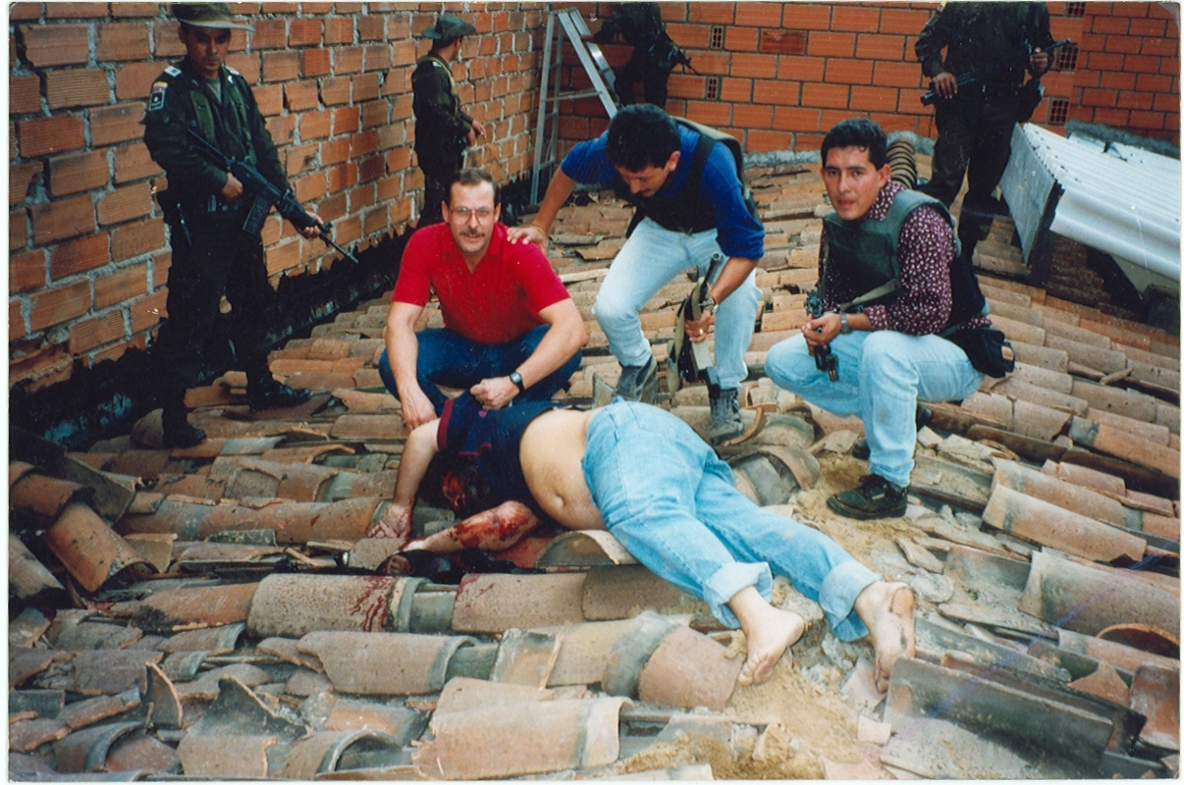
Former Bluefield Police Officer: Steve Murphy

Slide 3
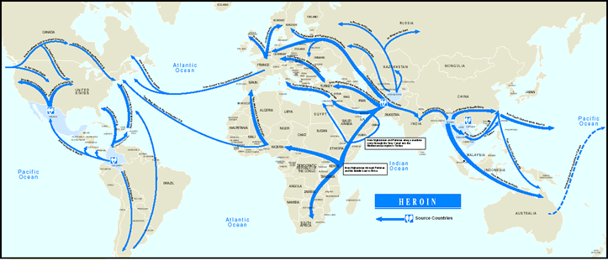
Heroin Source Regions

Slide 4
Meanwhile in Sinaloa: Change is in the Air
MEX/T: Crudely manufactured, pasty, gummy tar heroin from Mexico…
MEX/BP: Crudely manufactured brown powder heroin from Mexico…
MEX-SA: Refined to highly refined product that resembles SA heroin…
MEX: Refined or crudely manufactured heroin from Mexico…
INC-SA: Refined to highly refined product that resembles SA heroin with an “Inconclusive” origin…

Slide 5
Domestic Monitoring
Program
95 - 5

Slide 6
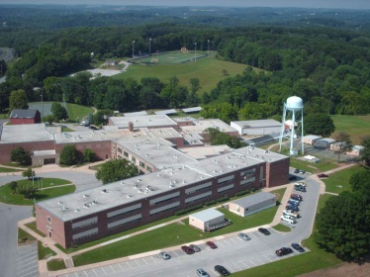
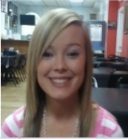
Face of Heroin Update

Slide 7
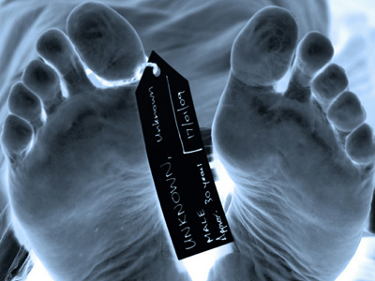
FYI…
White House Declares a Heroin Epidemic; Announces Plans to Stem Flow of Pain Meds
Heroin Deaths Quadruple in U.S. Since 2000
526,000 Americans in Treatment
Women/Youth/Private Insured/Higher Income/ Rural/Suburbs = Highest Growth Areas

Slide 8
4/5

Slide 9
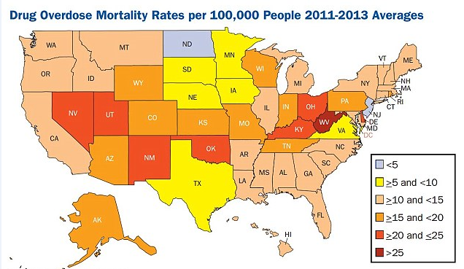
Record WV Fatal OD’s

Slide 10
Dope Economics for Idiots
2 Pills = $160
vs
4 Caps = $40

Slide 11
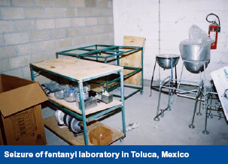
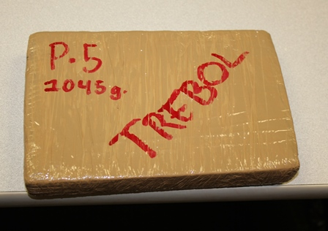
Toluca – 2005-2007

Slide 12
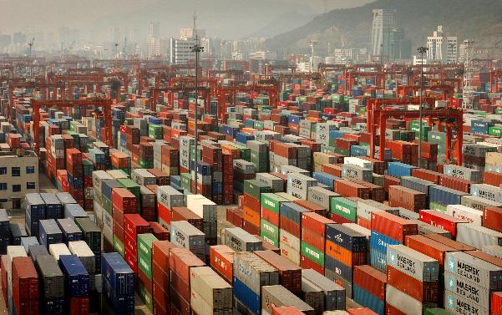
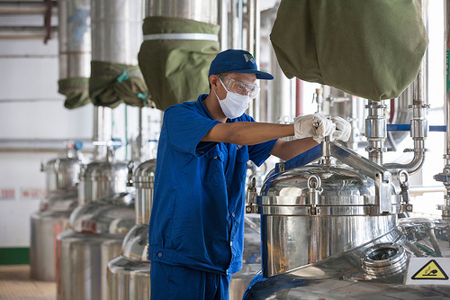
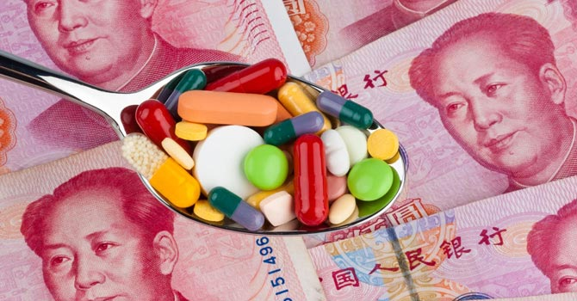
Fentanyl: From China With Love
160,000
Shanghai Wonderful Trading
$2500 kg
Egbert Ltd.
$3800 kg

Slide 13
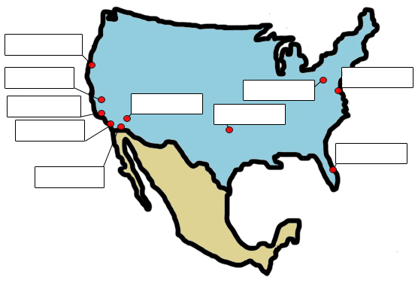
Widespread U.S. Bulk Fentanyl Seizures
San Clemente, CA
5.9 kg 4/15/14
Artesia, CA
500 gr 5/1/13
New York, NY
2 kg 12/3/14
Abington, PA
3 kg 9/19/14
Calimesa, CA
5 kg 11/1/13
Westmoreland, CA
5 kg 1/29/14
Baltimore, MD
1 kg 6/1/14
Oklahoma City, OK
1 kg 3/1/14
San Diego, CA
1 kg 5/27/14
West Palm Beach, FL
5 kg 3/17/14
Otay, CA
1 kg 11/1/13

Slide 14
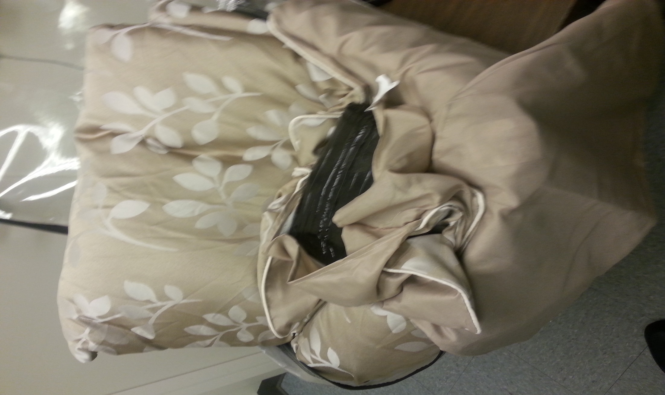
Fentanyl Seizure

Slide 15
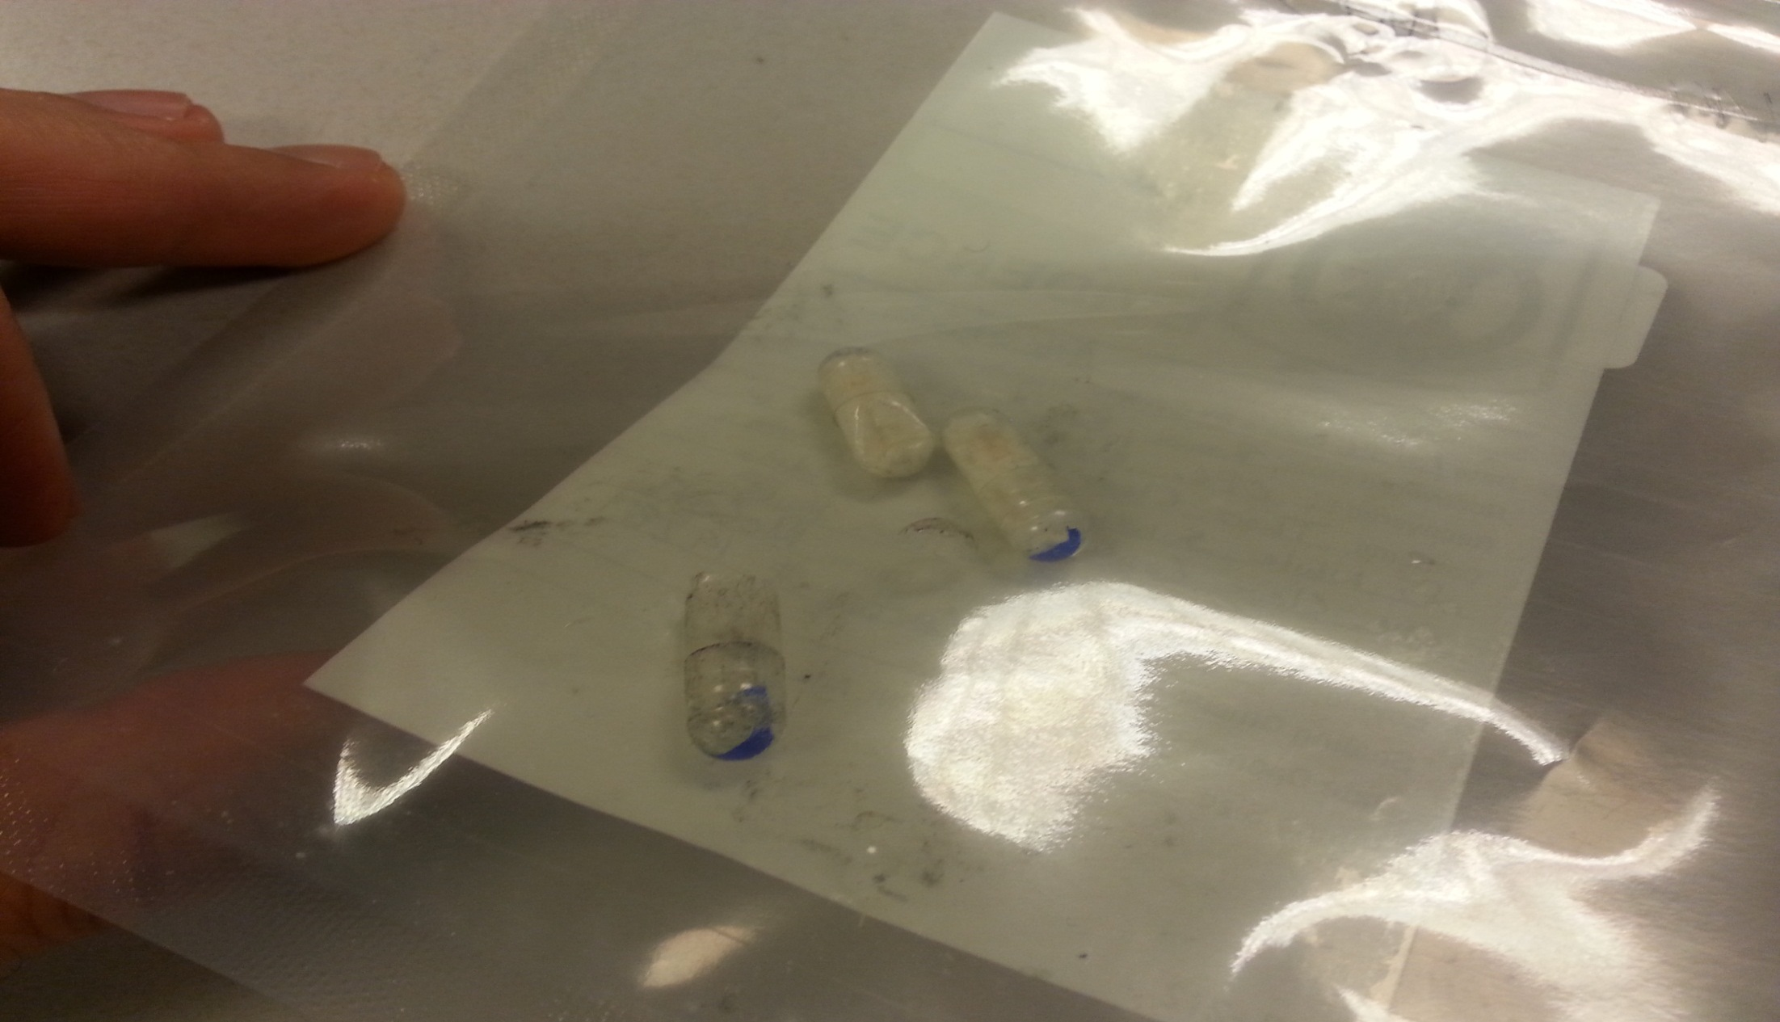
Heroin with Fire: More Lethal Than a Handgun
75 OD’s in 72 hours
in Chicago

Slide 16
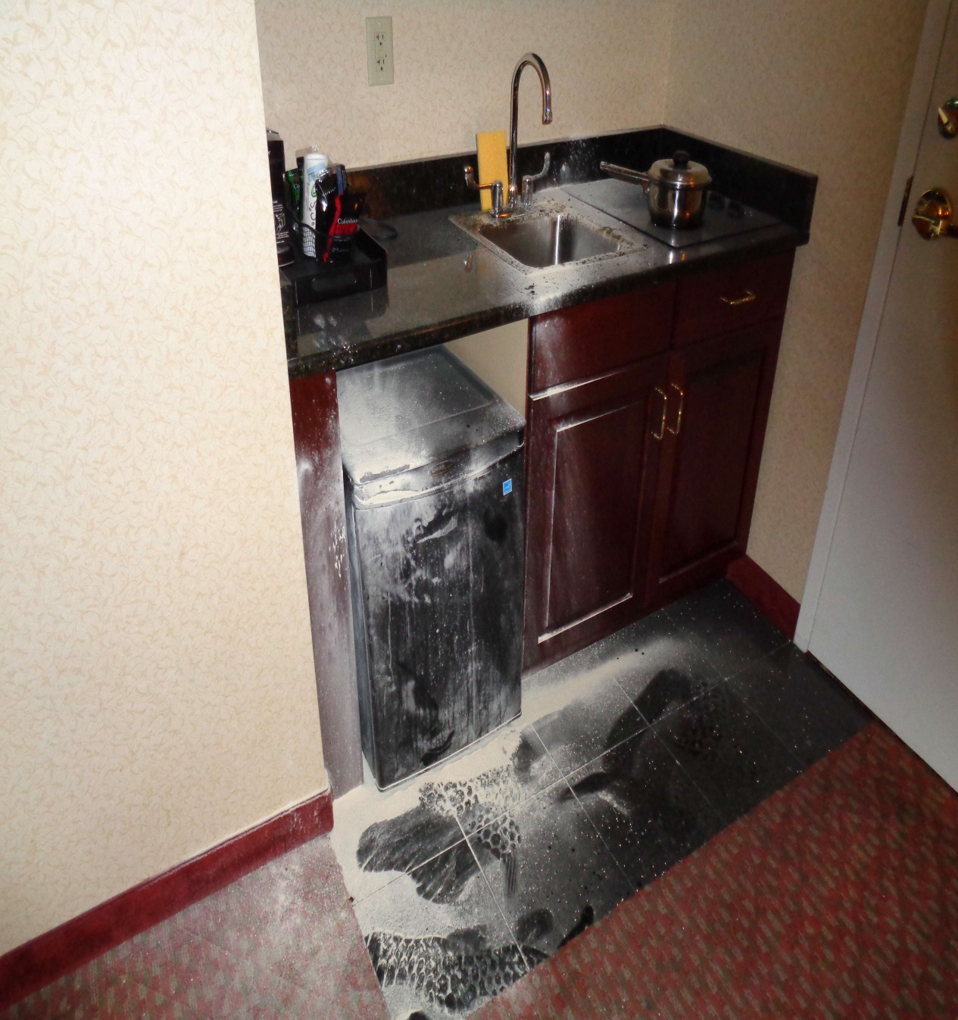
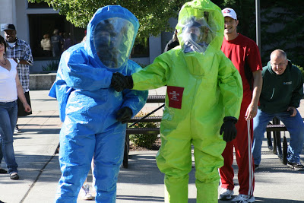
An Officer Safety Issue: Handling Fentanyl
Risk to Law Enforcement
Naloxone Training

Slide 17
U.S. vs the World
/57%
of morphine

Slide 18
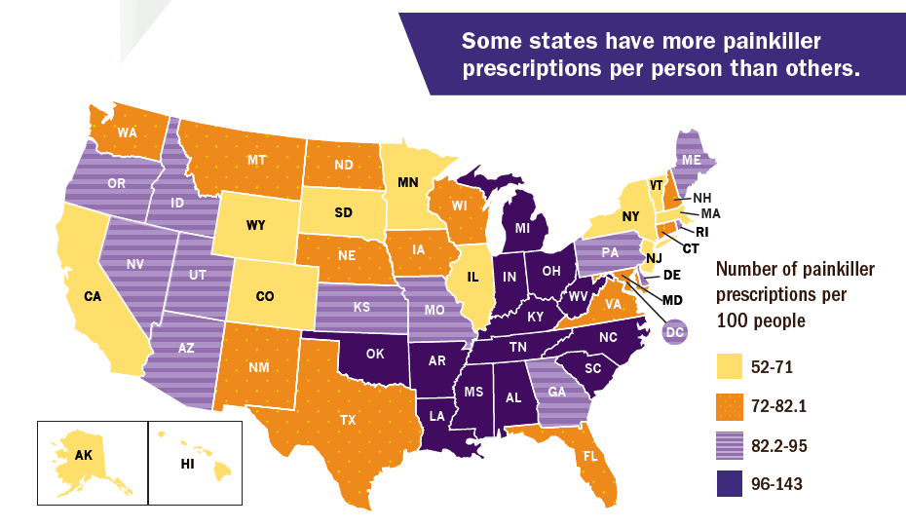
Where You Live Makes a Difference

Slide 19
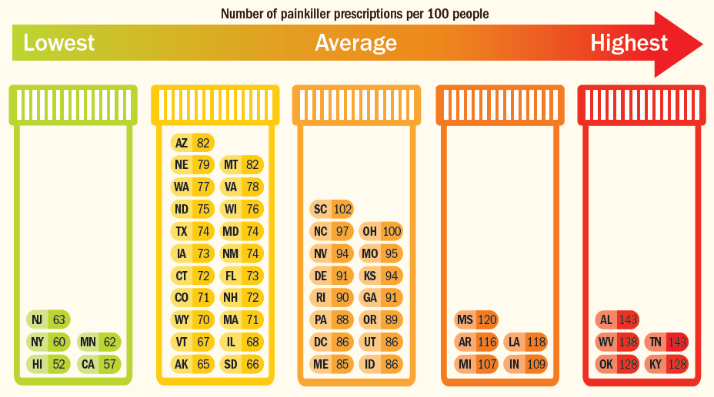
WV: You’re # 3

Slide 20
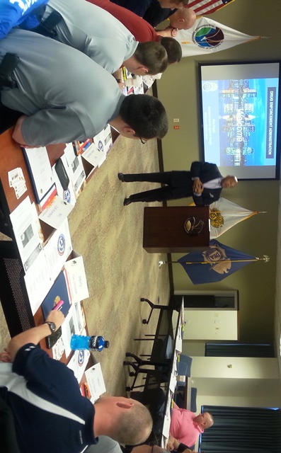
Education & Awareness Best Practices
Enhanced Professional Education
Social Awareness Campaign

Slide 21
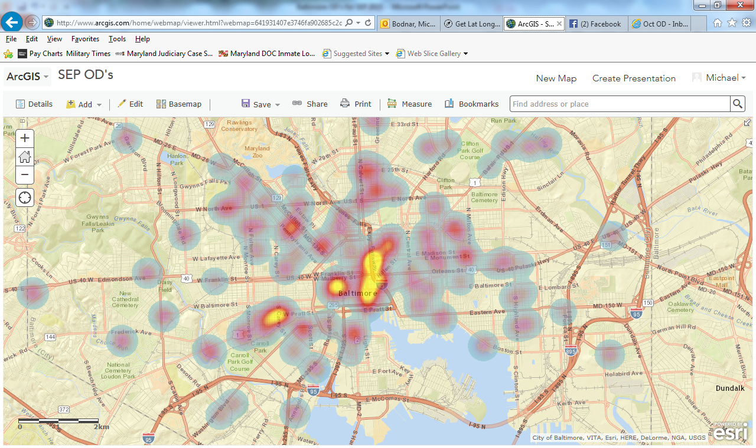
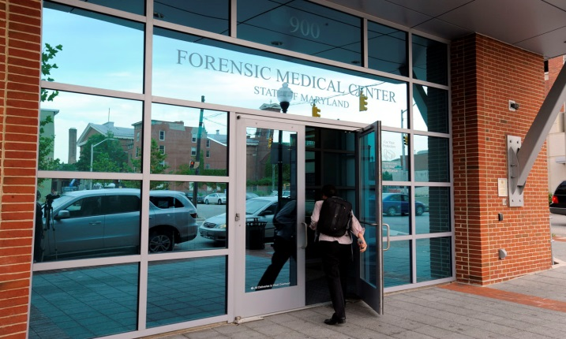
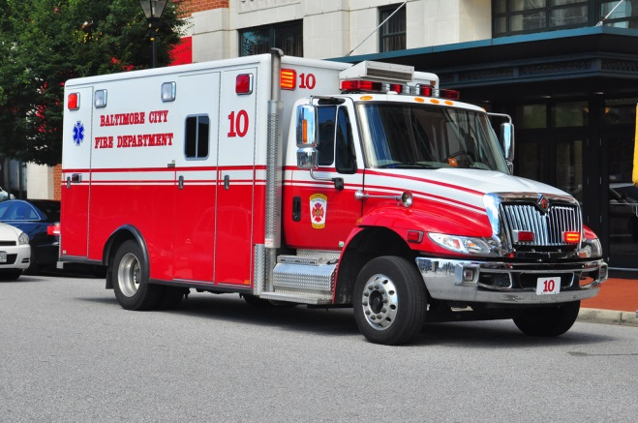
Bio-Surveillance A Best Practice
Making a Difference in an Epidemic of Fentanyl Deaths in Maryland-
Geographic Information Systems (GIS) and Collaboration with the DEA

Slide 22
What Can MDs Do? Best Practices
Use PDMP
Remove Effective Treatment Barriers
Buprenorphine / Methadone
Discuss Risks & Benefits with Patients
Follow Best Practices
Screen for Substance Abuse / Mental Health Issues
Prescribe Lowest Effective Dose

Slide 23
What Can Consumers Do? Best Practices
How will my pain be managed before, during and after surgery/injury?
How much discomfort is usually associated with this procedure/injury?
What non-narcotic pain control options do I have?
What side effects can I expect?
How will I manage long-term pain?

Slide 24
We Can’t Arrest Our Way Out of This One…
Community
(Outreach, Education & Prevention)
Diversion / Regulatory
Enforcement
(Local, State & Federal)

Slide 25
A Problematic Progression: The Macro View
Pill Abuse
Heroin Addiction
Gang Distribution and Violence
Cartel Supply and Oversight

Slide 26
Targeting the Strategic Link
We Are
the
Link
Point
Distribution, Violence, ODs
Cartel Drug Supply
Leverage enforcement resources & focus on the link point.
Provide “Time and Space” for Community Efforts.

Slide 27
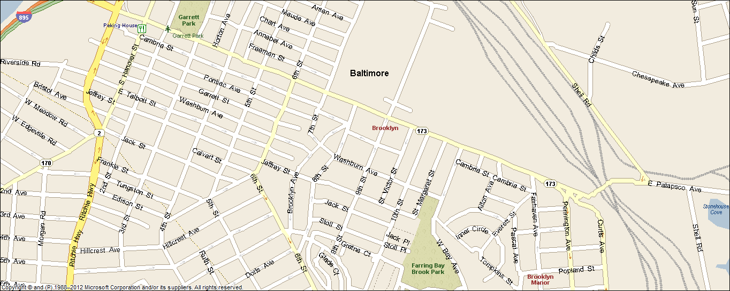
4200 6th St
August 17, 2015
HOMICIDES
100 W. Patapsco Ave.
May 7, 2015
Trojan Horse Meets War Room
3600 St Victor St
May 13, 2015
3700 St Victor St
October 26 2014
3700 St Margaret St
June 17, 2015
1300 Pontiac
July 18, 2015
3900 9th Street
September 3, 2015
900 Dantrey Ct
May 1, 2015
800 Gretna Ct
May 29, 2015
4300 West Bay Ave.
June 8, 2015
4200 10th St
August 17, 2015
4142 Audrey Ave.
April 8, 2015
4100 Hague Ave.
August 31, 2015
4100 Hyden Ct
July 11, 2015

Slide 28
Thank You!
U.S. Drug Enforcement Administration
United States Attorney for Maryland
OCDETF Mid-Atlantic Region
States Attorney Offices throughout MD
State Fusion Centers in MD,VA, PA, NJ, NE
DEA-SOD
DEA-Fusion Center
Washington - Baltimore HIDTA
El Paso Intelligence Center
Federal Bureau of Investigation
Maryland Army National Guard
Maryland State Police
Baltimore City Police Department
Baltimore County Police Department
Annapolis City Police Department
Anne Arundel County Police Department
Frederick County Sheriff’s Office
Howard County Police Department
Harford County Sheriff’s Office
Cecil County Sheriff’s Office
Carroll County Sheriff’s Office
Wicomico County Sheriff’s Office
Washington County Narcotics Task Force
Kent County Sheriff’s Office
Governor’s Office of Crime Control and Prevention in Maryland
U.S. Coast Guard
Office of the Chief Medical Examiner for MD
MD Department of Health & Mental Hygiene
Johns Hopkins Bloomberg School of Public Health
Johns Hopkins University School of Nursing
Partnership for a Safer Maryland
Chesapeake Region Safety Council
AA Co. Health Department and Public Schools
Behavioral Health System Baltimore
Baltimore City Health Department
Mayor of Baltimore’s Heroin Treatment & Prevention Task Force
Outcome-Stat- Baltimore’s Strategic 5-Year Plan
Baltimore City Fire Department- EMT
EMT Services throughout MD
R. Adams Cowley Shock Trauma Center
Carroll Co Health Department and Public Schools
Harford Co Health Department and Public Schools
Howard County Health Department
Prince George’s County Health Department
Washington County Health Department
U.S. Army Cyber Command
U.S. Army and Civilian Employees– Ft. Meade
U.S. Naval Academy
Maryland DARE
Maryland State Child Fatality Review Team
The Families & Friends of MD’s Fatal OD Victims

