Slide 1
Rooted in Jesus 2020: ABCD of disaster response

Slide 2
Agenda
Bible Study
What is ABCD?
Responding to Disasters with our Gifts
Developing next steps and commitments

Slide 3
Bible Study 2 Kings 4: 1-7
The wife of a man from the company of the prophets cried out to Elisha, “Your servant my husband is dead, and you know that he revered the Lord.
But now his creditor is coming to take my two boys as his slaves.”

Slide 4
Elisha replied to her, “How can I help you? Tell me, what do you have in your house?”
“Your servant has nothing there at all, “ she said, “except a small jar of olive oil.”
Elisha said, “Go around and ask all your neighbors for empty jars. And not just a few. Then go inside and shut the door behind you and your sons. Pour oil into all the jars, and as each is filled, put it to one side.”

Slide 5
She left him and shut the door behind her and her sons. They brought the jars to her and she kept pouring. When all the jars were full, she said to her son, “Bring me another one.”
But he replied, “There is not a jar left.” Then the oil stopped flowing. She went and told the man of God, and he said, “Go, sell the oil and pay your debts. You and your sons can live on what is left.”

Slide 6
FAMA Method - TOOL
Facts: Reflect on what you have just heard, seen or done
Association: Connect the experience to your own feelings/lives
Meaning: Explore the deeper meaning of what you just heard, seen or done
Action: Incite people to action

Slide 7
WHAT’S ABCD?

Slide 8
ASSET BASED COMMUNITY DEVELOPMENT
Asset Based Community Development (ABCD) is a strategy for sustainable community driven development.
ABCD builds on the assets that are already found in the community and mobilizes individuals, associations, and institutions to come together to build on their assets.
https://resources.depaul.edu/abcd-institute/resources/Pages/tool-kit.aspx

Slide 10
Episcopal Relief & Development works through the Anglican Communion worldwide and The Episcopal Church to facilitate healthier, more fulfilling lives in communities struggling with hunger, poverty, disaster and disease.
Notes:
What is Episcopal Relief & Development

Slide 11
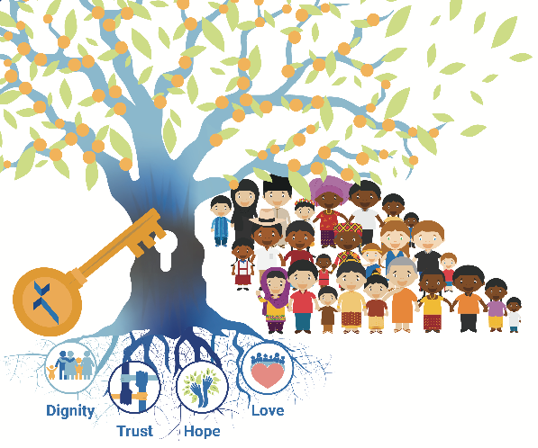
Unlocking of Abundance
Episcopal Relief & Development Strategic Plan 2017-2021

Slide 12
Core Program Areas

Slide 13
Assess Your Gifts

Slide 14
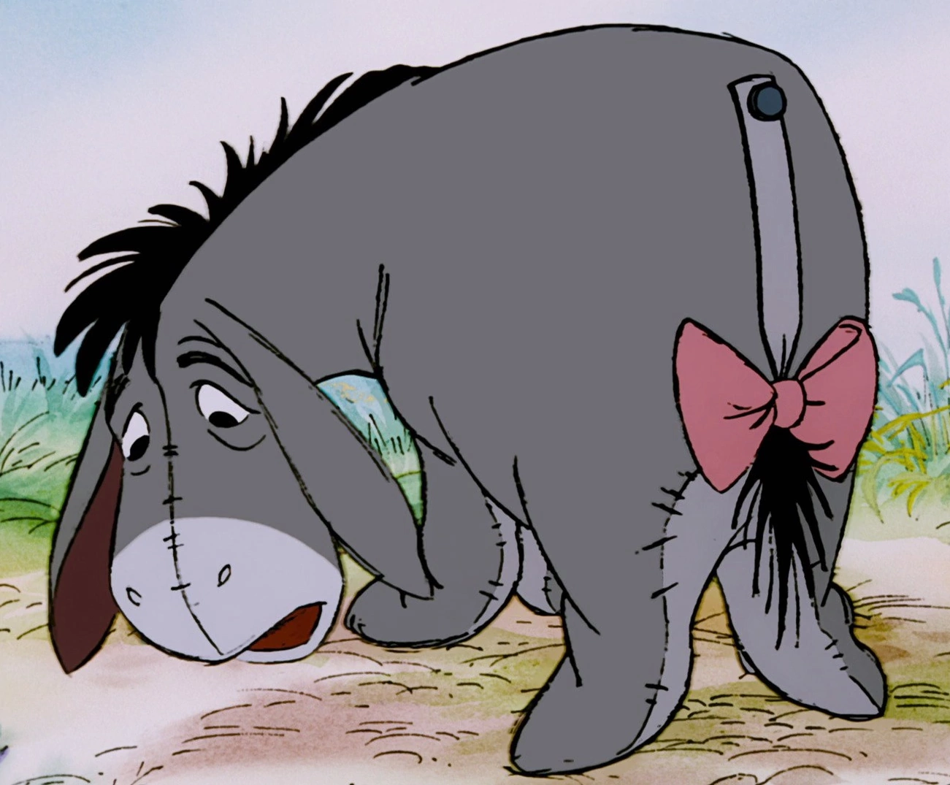

Slide 15
Two Tales of a City
Poverty
Food deserts
Crime
Hospital
After school programs
Families that love each other
Notes:
We have multiple ways of looking at a disaster and at the bad things that happen in our worlds and our lives. The goal is not only to see the good or just the see the bad, but to see both!

Slide 16
What do you have?
Post it activity
1:1 conversations
Prayer Walk
Asset Mapping

Slide 17
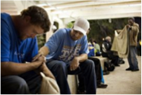
POST IT ACTIVITY
people
property
Programs
Purse
posture

Slide 18
Describe your ministry context
Form groups of 3-4
One person talks about their church
Others are listening for the gifts
i.e. we don’t have any children - we have a lot of adults.
Put one gift per a posit

Slide 19
POST IT ACTIVITY
people
property
Programs
Purse
posture

Slide 20
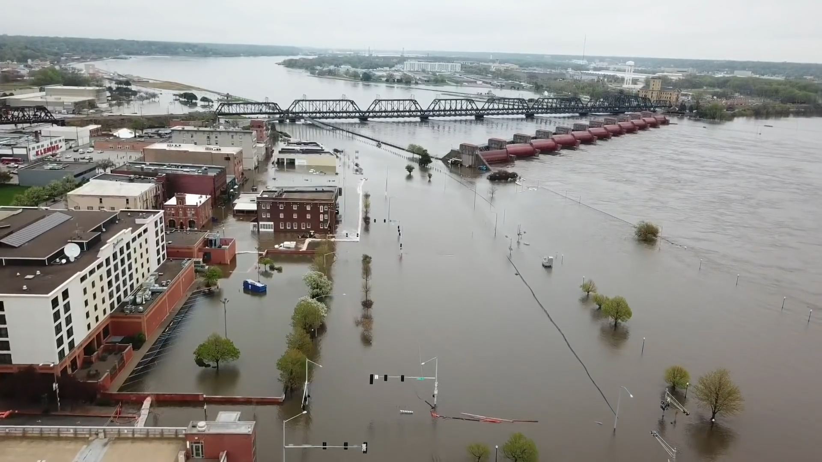
Notes:
Sorry to inform you, but you have just experienced a flood, and in your community. For some of you this is not a “practice run” it is the reality that you have experienced, will experience or are
Your ministry building and property is ok, it safe to get to your property from most of the community. There is some flooding in the area that has damaged homes. Folks have been displaced and are in shelters.

Slide 21
Community Need
One Need per a post - it
Brainstorm what possible needs might be present in your community
Keep in mind:
Vulnerable community
Disproportionately impacted communities
Physical, spiritual, emotional, financial, electronic, etc…

Slide 22
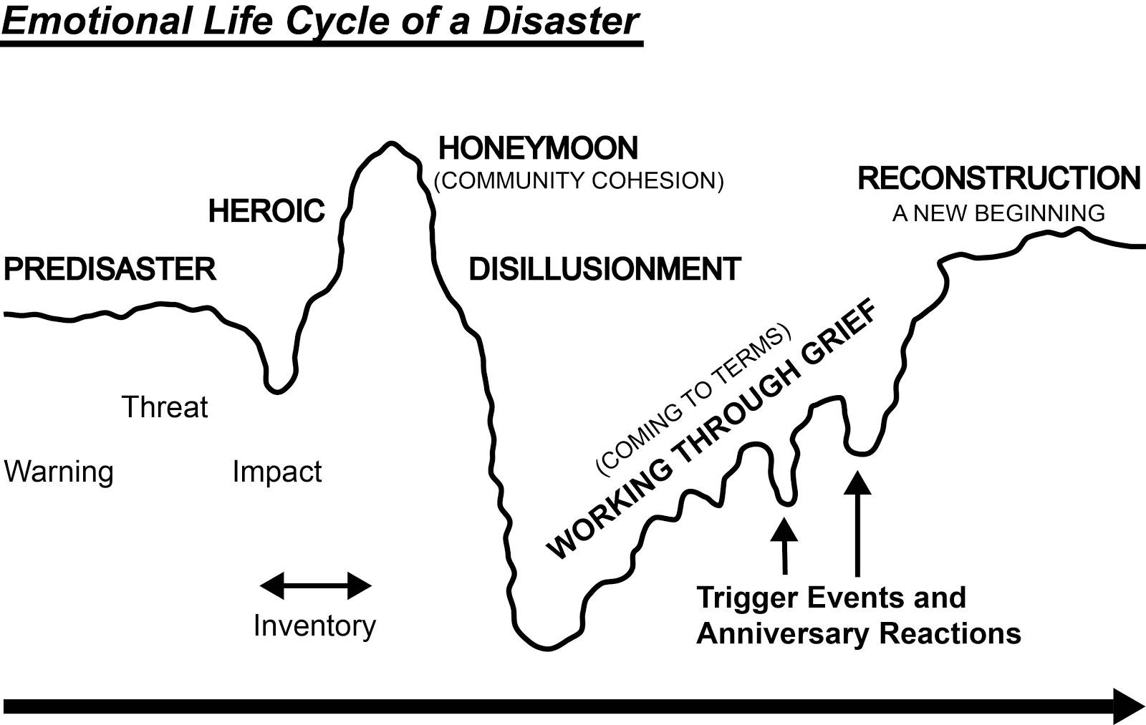

Slide 23
Circle of Needs
Community
Church/
Congregation

Slide 24
After disasters communities need: C.I.A.
Community
Information
Agency

Slide 25
Gifts
NEEDS

Slide 26
Match
Look at your list of gifts
Look at your lists of needs.
What gifts that you currently have could be used to address a need?

Slide 27
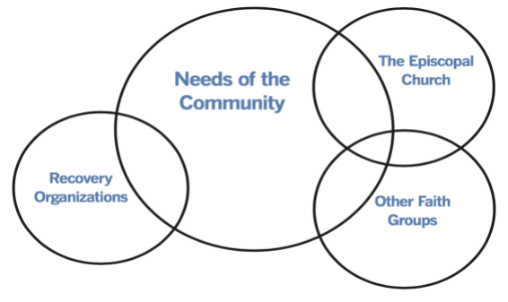

Slide 28
Report Back
Ministry Context in town, state could use its gift of (gift) to respond to the need of (need).

Slide 29
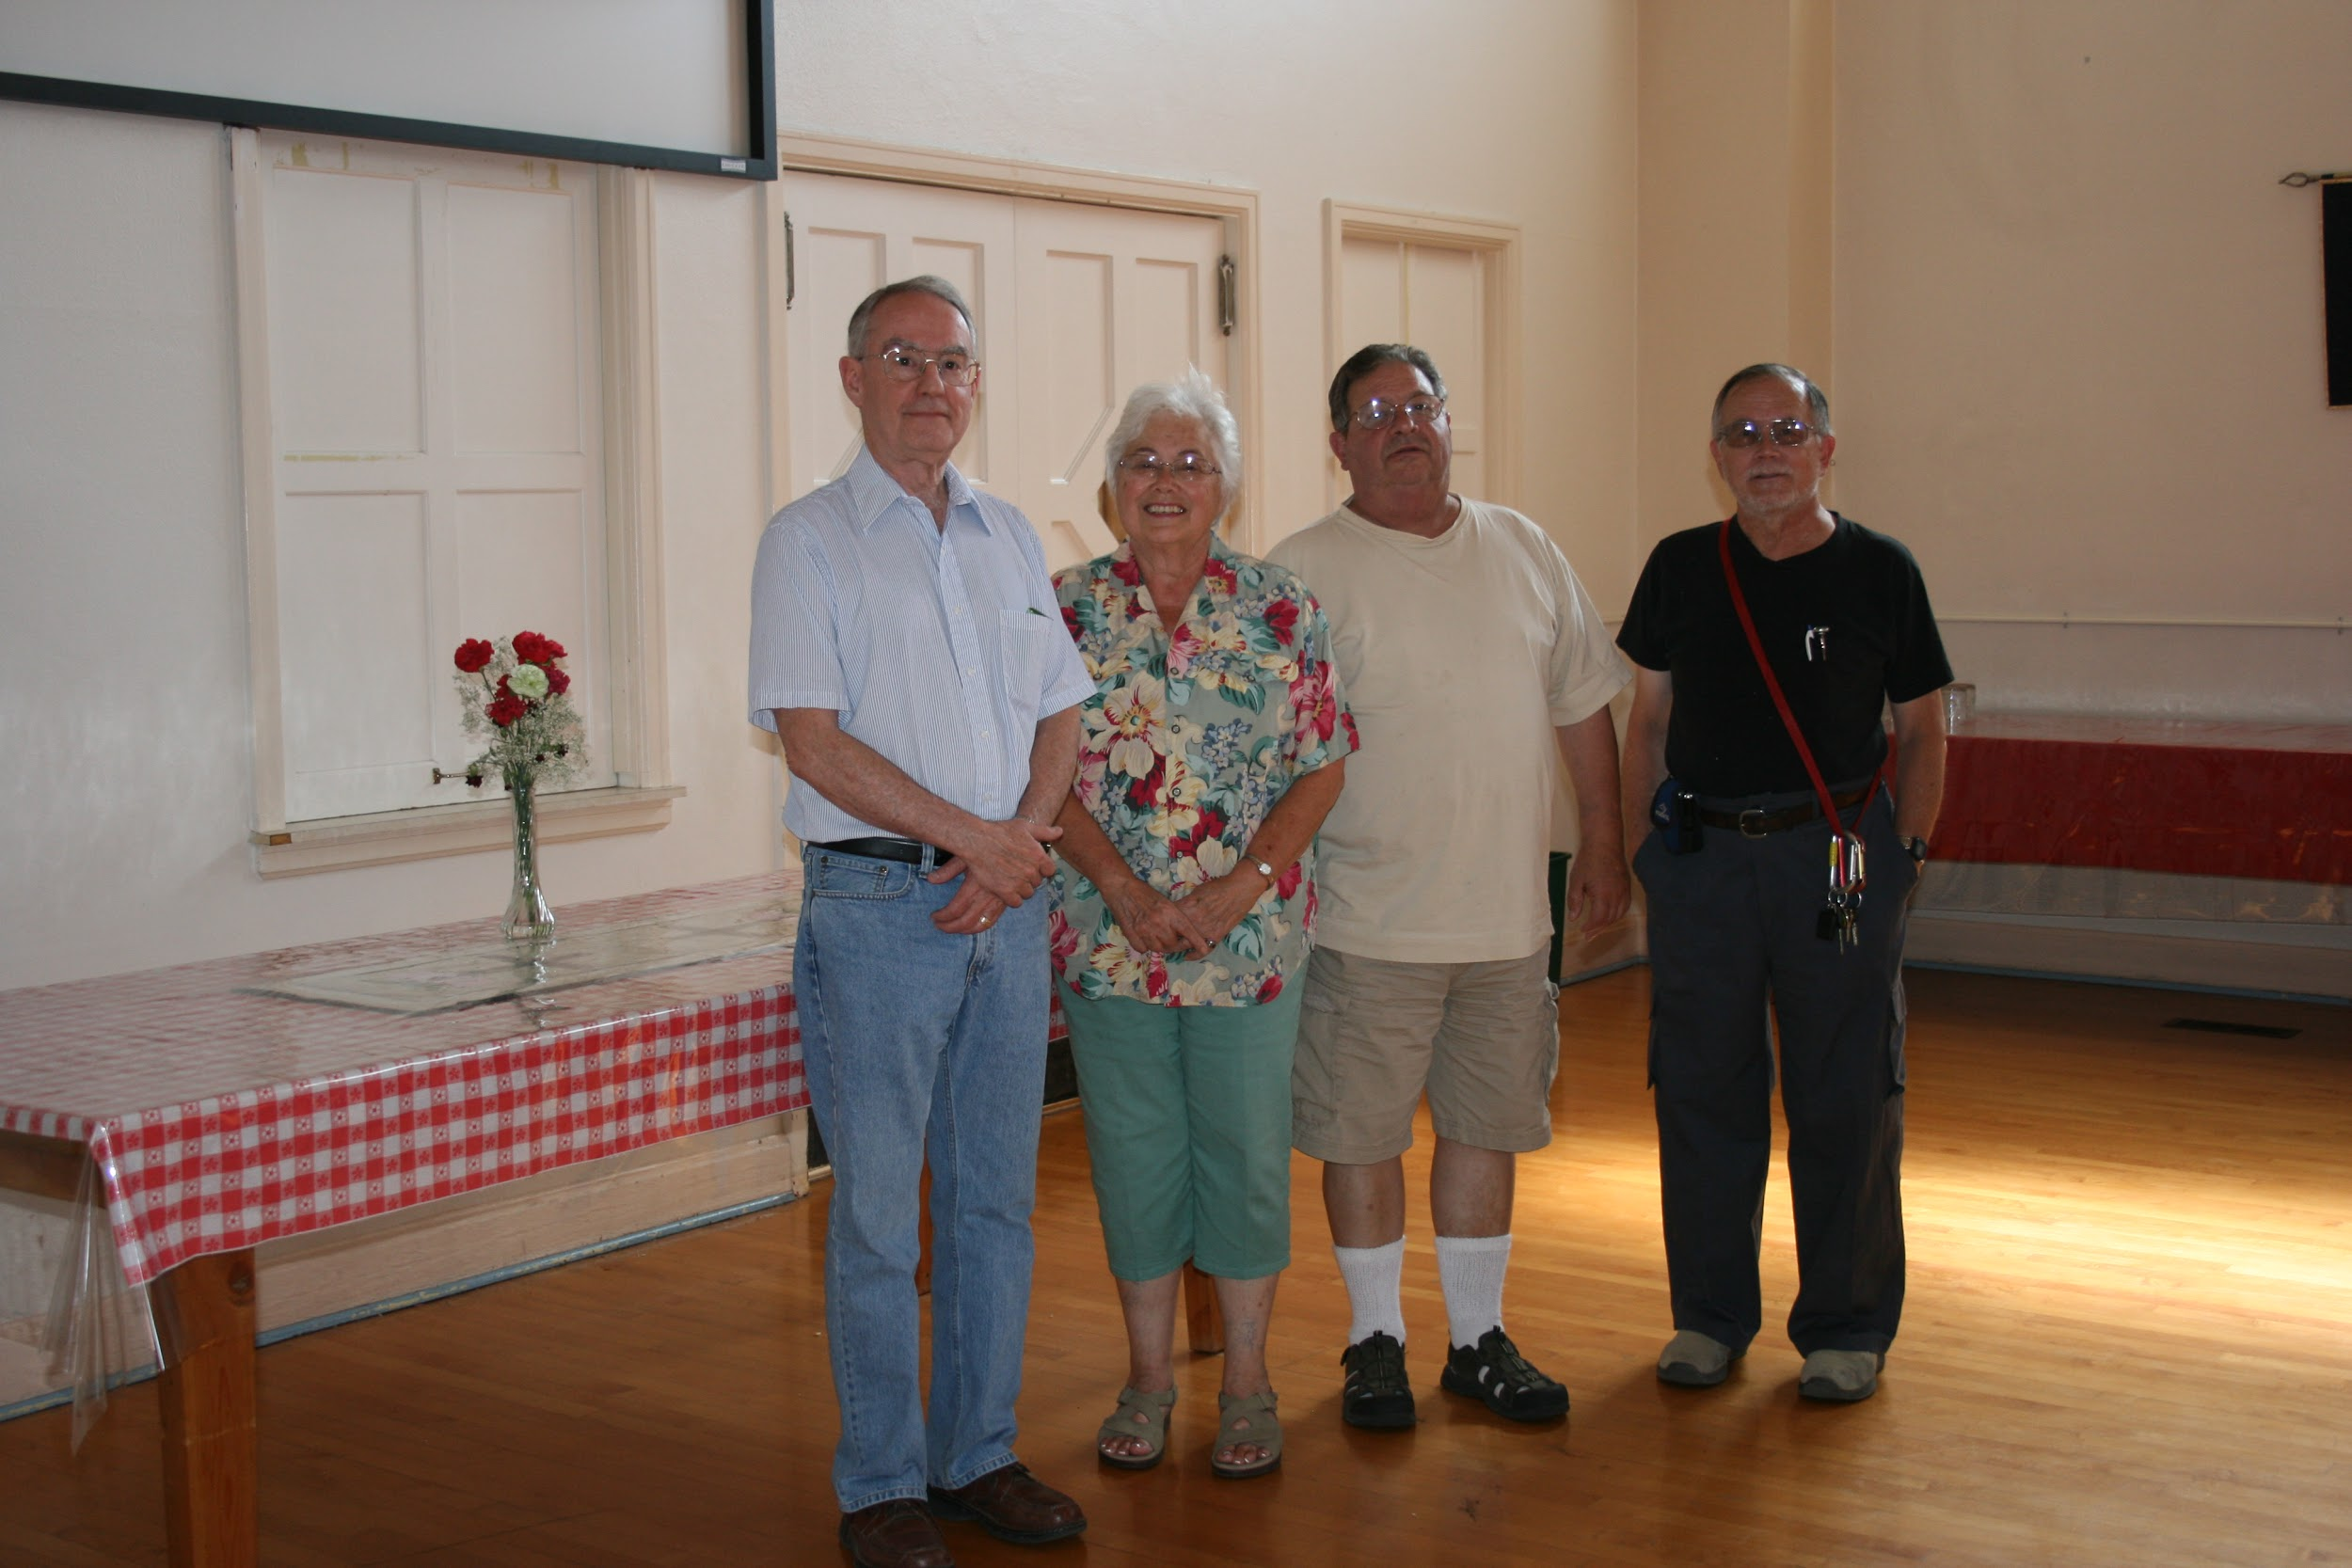
Diocese of Eastern Oregon:
A fire across the street from the church
Air conditioning
Snacks
Wifi
A place for first responders to rest
Empty parish hall until 6 p.m.
Snacks!
A volunteer to rearrange the chairs
Cooling shelter for first responders
Notes:
There was a fire across the street from the church. And it was a very hot day. The first responders needed a place to get their vitals checked at specific intervals. The church had an aire conditioned hall, the ability to prepare snacks and wifi.

Slide 30
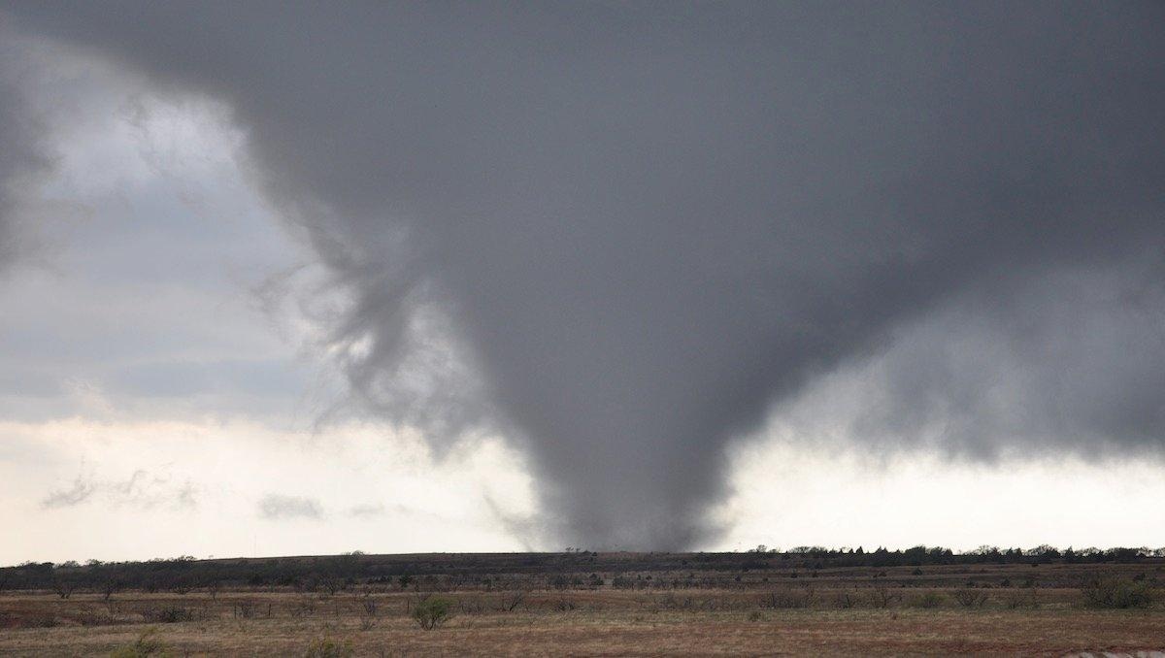
Diocese of East TN: Tornadoes
Soft food
Comfort
New medical devices
Feeding ministry
Relationships with professionals
Access to funds

Slide 31
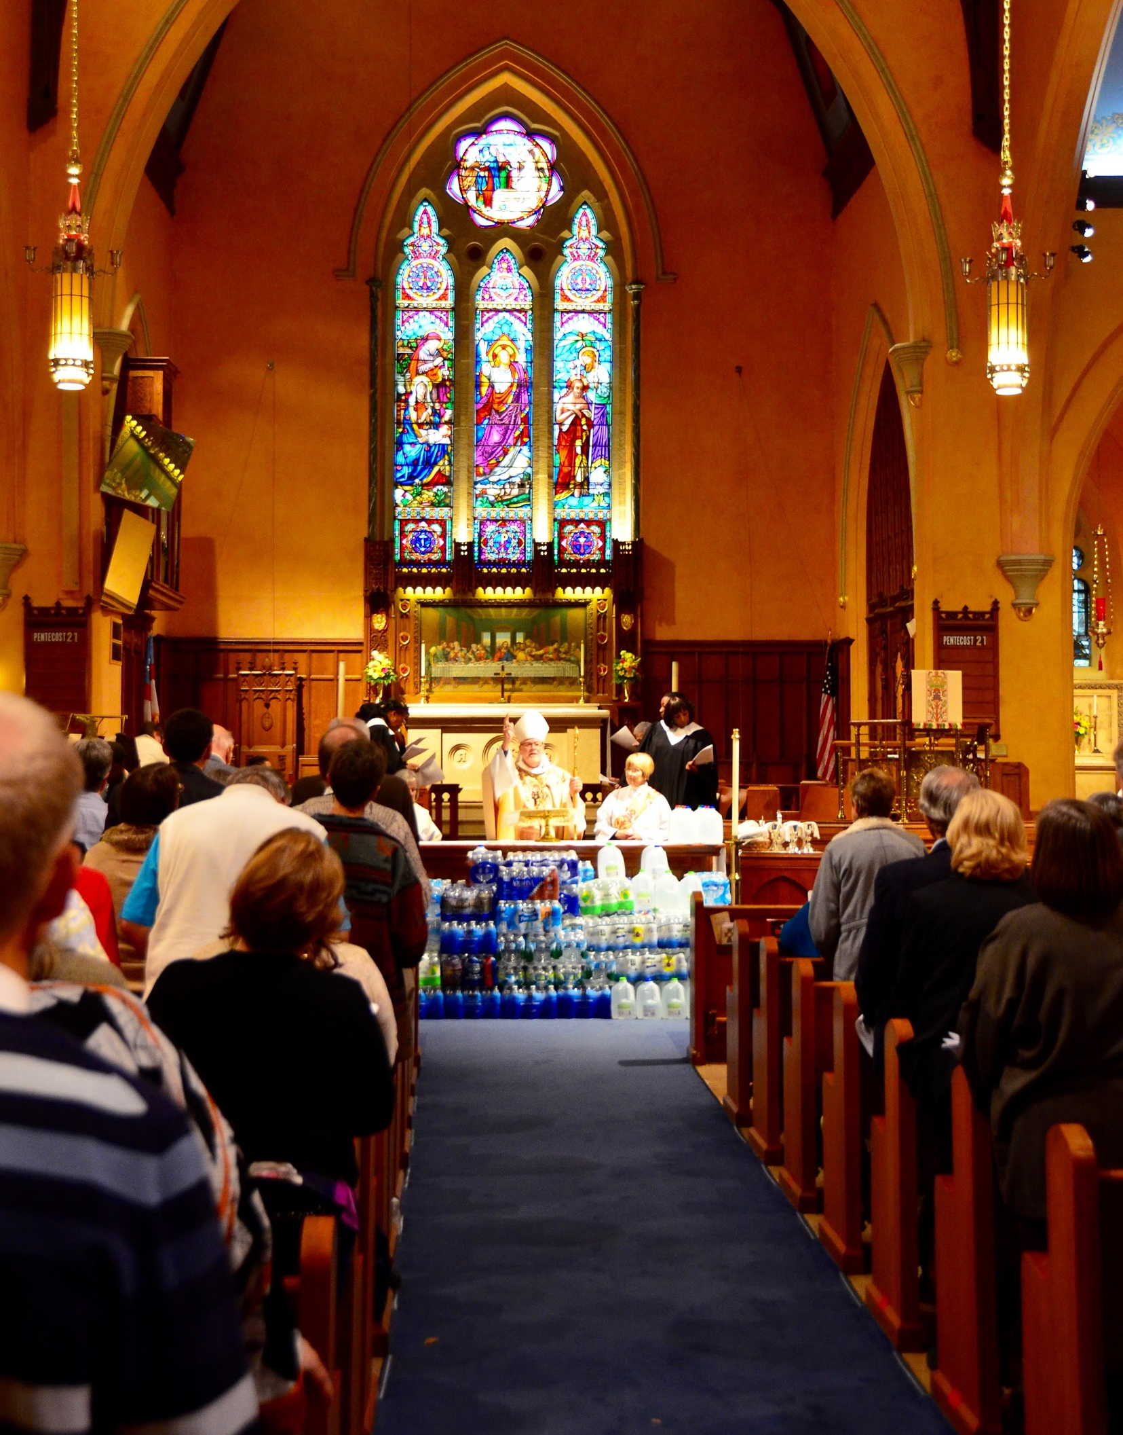
Diocese of Eastern Michigan: Water Crisis
Safe water
Ways to mitigate the effect of lead
Economic opportunities
Connections to caregivers
After school programs
Invested in the community
Cooking classes, partnerships with local grocery stores, tutoring, water filter distribution, and more!

Slide 32
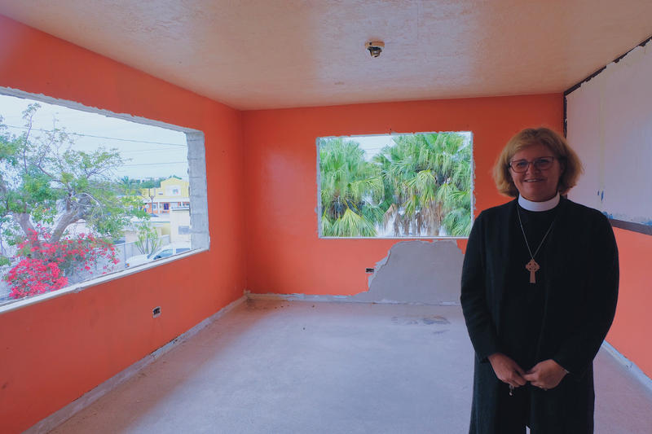
Diocese of Southeast Florida:
Hurricane Irma
Emergency shelter
Affordable housing
Volunteers
Ministry space
Connections to donors
Big dreams
New affordable housing apartment complex managed by the church
Notes:
Photo from: Klingener, Nancy. “Middle Keys Church Tackling Housing Crisis Head-On” LRN http://www.wlrn.org/post/middle-keys-church-tackling-housing-crisis-head?fbclid=IwAR1b7WU2VCGImjvi31v1mFB7SEghWBB5xQbhb9rgADDmF86AuQMjA3loJgY

Slide 33
KNOW THE NEIGHBORHOOD

Slide 34
Listen For the Call
Prayer Walks - What’s God up to out there?
1:1 Conversations - listening deeply and sharing
FAMA Bible Study -
Facts
Association,
Meaning
Action

Slide 35
Prayer Walk (Tool)
Walk around the neighborhood - or drive
Pray for what you see
Give thanksgiving
Ask for Grace
Notice how you are seeing

Slide 37
BUILD BRIDGES

Slide 38
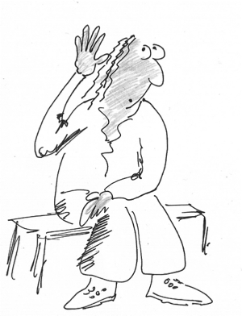

Slide 39
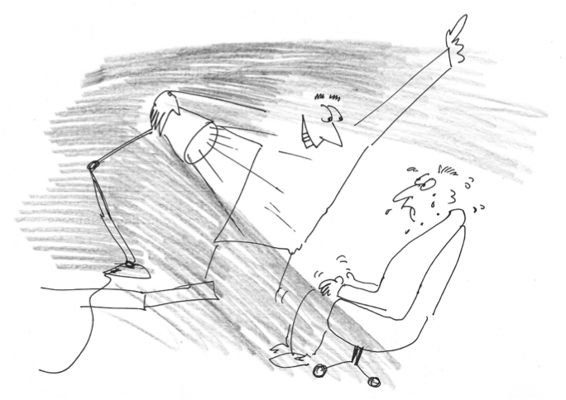

Slide 40
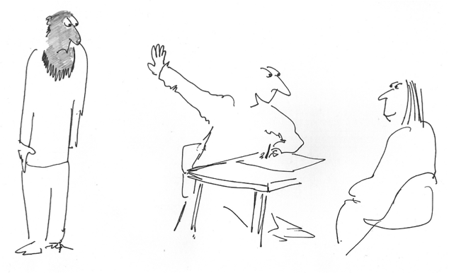

Slide 41
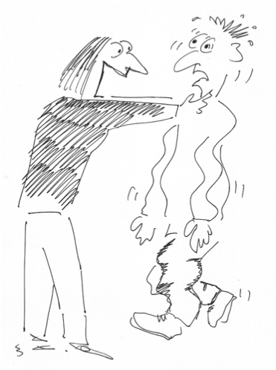

Slide 42
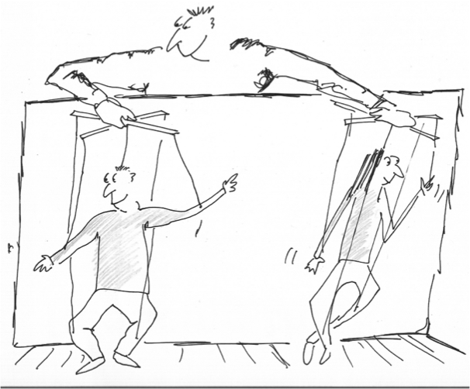

Slide 43
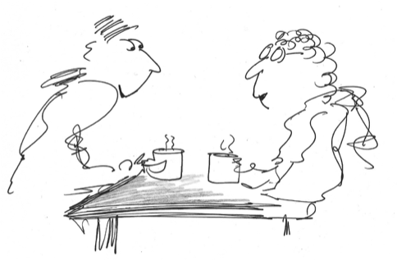

Slide 44
Takeaways
Words create worlds
Inquiry creates change
What you focus on grows
Images inspire action
Positive questions lead to positive change

Slide 45
Takeaways
Start with the easy wins.
Make sure that it is a call of the whole community.
Build bridges.
Being appreciative does not erase pain.
Build partnership and create the dream together.
God is out there, at work in the world - join the party.

Slide 46
Make a plan
Choose a post it
Write down two steps that you can take in the next month.
put your email on that post it
exchange with someone else and follow up in a month.

Slide 47
Thank You !

